Slide 1

PYTHON DATA ANALYSIS
REPORT
Name: Bhardwaj Joshi
Course: B.Sc. CS-IT
Data: 27.12.2025

Slide 2
Dataset Overview
Number of Records:
20 students
Columns Used:
StudentID
Student Name
Age
Gender
Course
Marks
Purpose of Dataset:
To analyze student performance across different courses using python

Slide 3
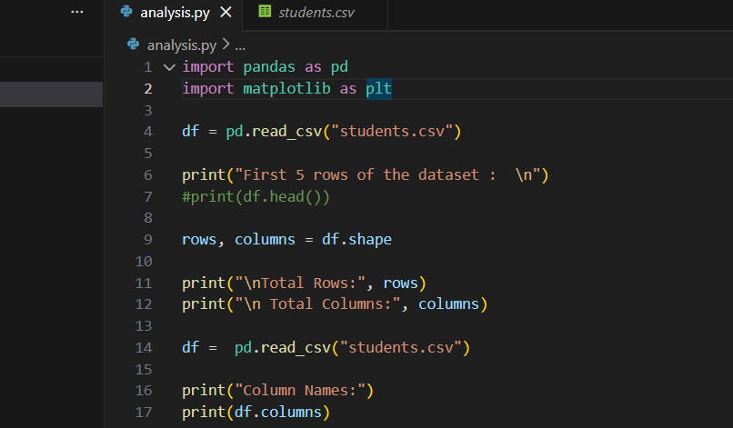

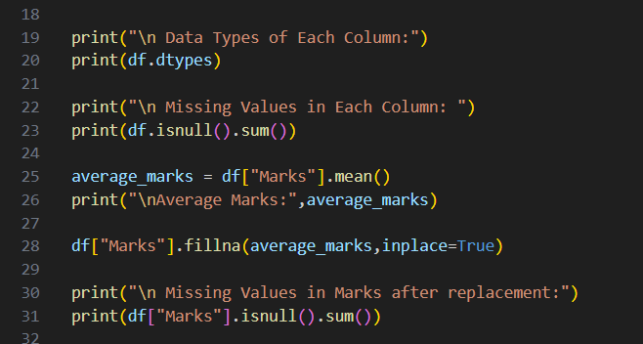
Data Cleaning
Missing Values Found:
No missing values detected in the dataset
Data Cleaning Steps:
Dataset was checked using pandas functions.
No rows or columns were removed as data was complete

Slide 4
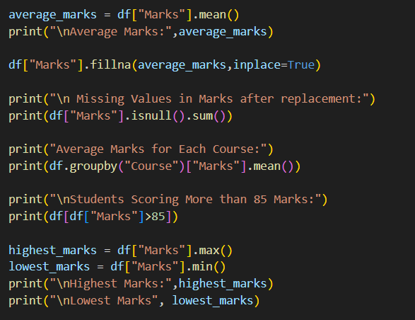

Analysis insights
Average Marks by Course:
Python: High overall performance.
Data Science: Consistent scores.
Web Development: Moderate Performance.
Machine Learning: Highest average marks.
High-Scoring Students:
Students scoring above 85 marks were
identified
Majority belonged to Machine Learning and Python courses

Slide 5
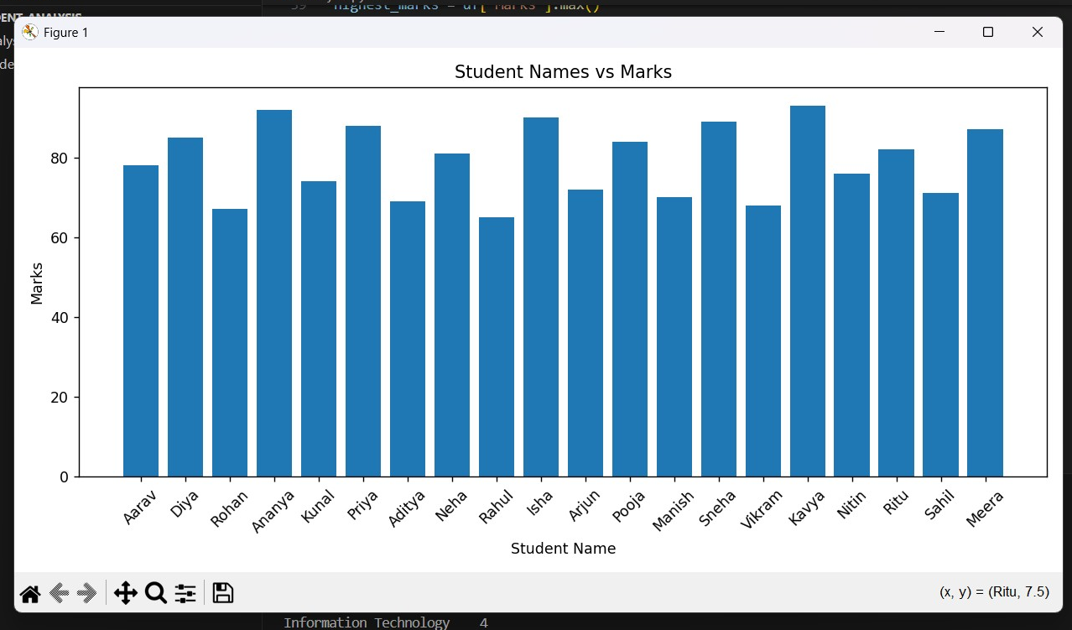
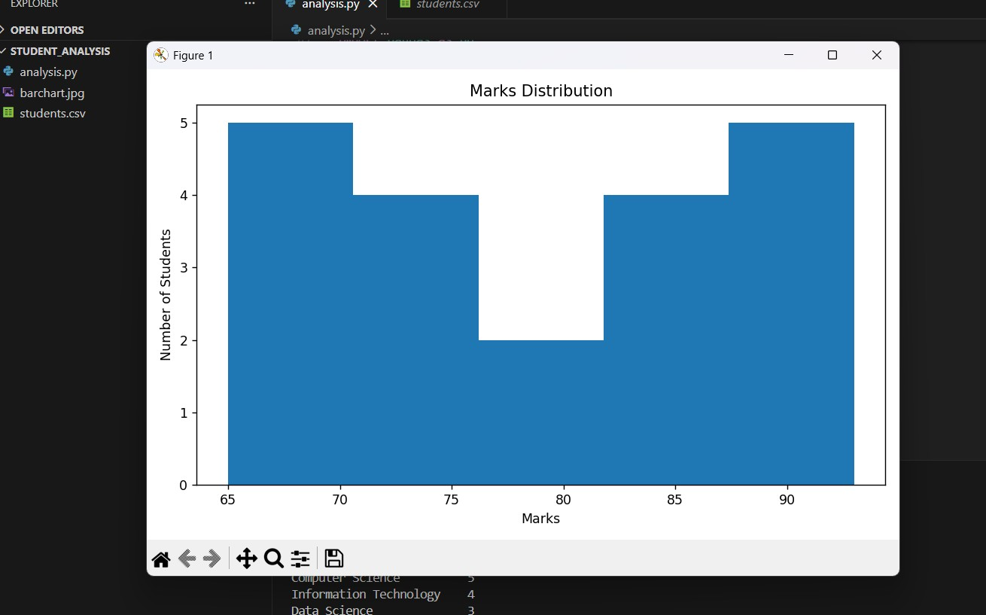
Visualization
Bar Chart: Shows student-wise marks distribution
Histogram: Displays overall marks distribution
Visualization help understand :
Performance trends
Score Frequency and Spread

Slide 6
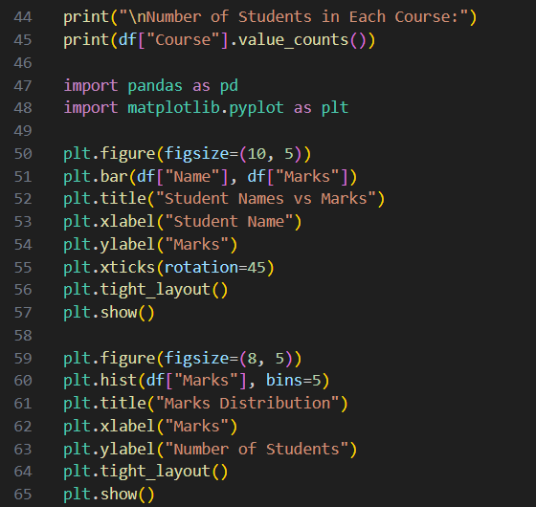
Conclusion
Key Insights:
Machine Learning students performed the best on average.
Most Students scored between
75 and 90 Marks.
Learning Outcome:
Learned how to load, clean, analyze, and visualize data
using python.
Gained hand-on experience with
pandas and matplotlib.
ENHANCING YOUR PRESENTATION

